Slide 1
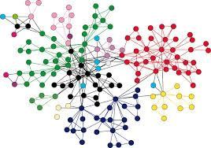
COMP 2310 Data Structures and Algorithms
Lecture 10
Introduction to Graph Structures

Slide 2
What is a Graph?
We have seen that trees provide a flexible nonlinear structure based on hierarcical representation.
Graphs are also nonlinear structures like trees.
A graph consists of some nodes (or vertices) and connections among these nodes.
Graph structure is a generalization of tree structure in which limitation due to hierarchical relationships is removed.
Notes:
2

Slide 3
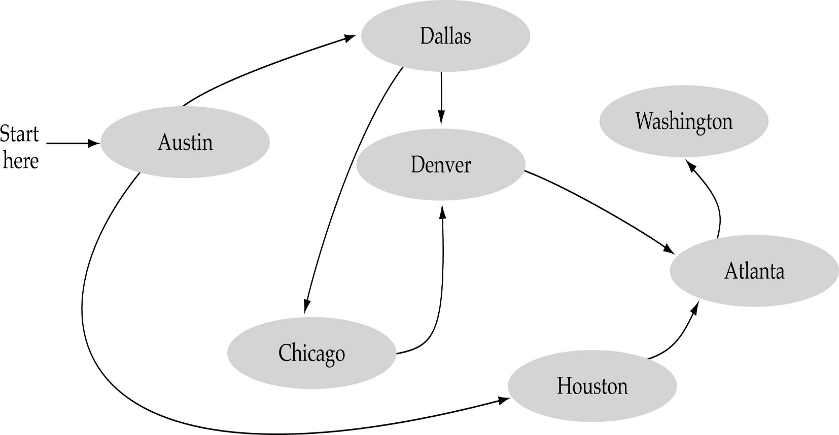
What is a Graph?
A data structure that consists of a set of nodes (vertices) and a set of edges that relate the nodes to each other
The set of edges describes non-hierarchical relationships among the vertices

Slide 4
Applications
Electronic circuits
Printed circuit board
Integrated circuit
Transportation networks
Highway network
Flight network
Computer networks
Local area network
Internet, Web
Databases
ER diagrams
Doing garbage collection (Compilers, Op.Systs.)
………………………………

Slide 5
Graph Definitions
A graph G=(V, E), consists of a set of vertices V and a set of edges E.
Each edge is a pair (v, w),where v and w are vertices:
Simple (Undirected) graph: A graph G=(V, E) consists of a nonempty set V of vertices and a set E of edges where
Edge (u,v) = Edge (v,u)
→ (u,v) is an unordered pair
Notes:
5

Slide 6
Graph Definitions
Directed graph (digraph): When the edges in a graph have a direction, the graph is called directed.
Difference between the simple graph and the directed graph:
Simple graph: For every edge
Directed graph: For every edge, vertices are ordered pairs.
Notes:
6

Slide 7
Graph Definitions: Examples
1
5
1
4
5
4
2
3
2
3
6
An undirected graph
A directed graph
Notes:
7

Slide 8
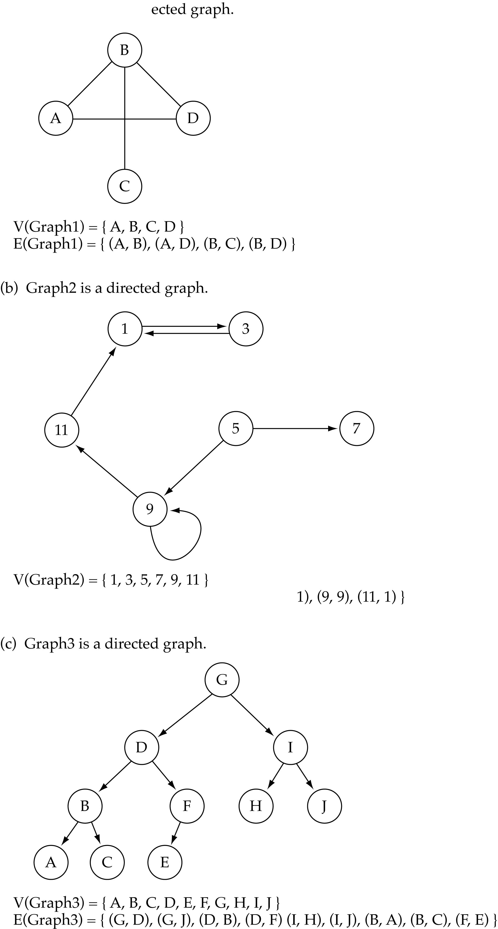
Graph Definitions: Examples
A directed graph: Graph and its vertex and edge sets
I

Slide 9
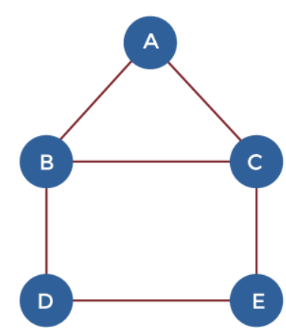
Graph Definitions
Walk: A walk is a sequence of vertices and edges of a graph.
If we traverse a graph then we get a walk.
Edge and Vertices both can be repeated.
Example Walks:
A, B, C, E, D (length = 4)
D, B, A, C, E, D, B, C (length = 7)
E, C, B, A, C, E, D (length = 6)
Walks, Trails, Path, Circuit and Cycle in Discrete mathematics - javatpoint
Notes:
9

Slide 10
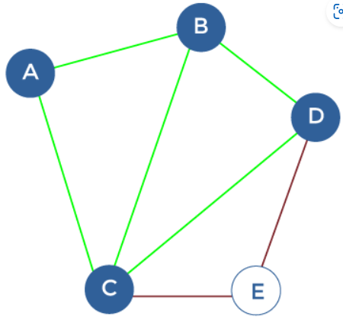
Graph Definitions
There are two types of the walk:
Open Walk: Vertices at which the walk starts and ends are different.
Closed Walk: Vertices at which the walk starts and ends are the same.
The edges and vertices can be repeated.
Examples:
Open walk = A, B, C, D, E, C
Closed walk = A, B, C, D, E, C, A
Walks, Trails, Path, Circuit and Cycle in Discrete mathematics - javatpoint
Notes:
10

Slide 11
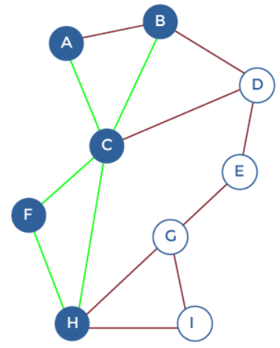
Graph Definitions
Trail: is an open walk where no edge is allowed to repeat. The vertex can be repeated.
Trail = A, C, H, F, C, B
Walks, Trails, Path, Circuit and Cycle in Discrete mathematics - javatpoint
Notes:
11

Slide 12
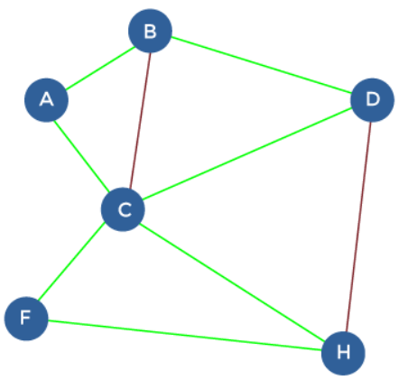
Graph Definitions
Circuit: is a closed walk where no edge is allowed to repeat. The vertex can be repeated.
Circuit: A, B, D, C, F, H, C, A
Walks, Trails, Path, Circuit and Cycle in Discrete mathematics - javatpoint
Notes:
12

Slide 13
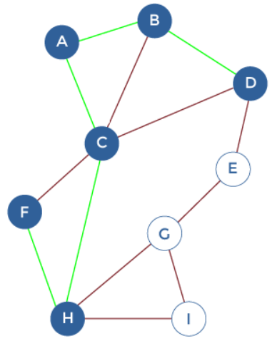
Graph Definitions
Path: is a open walk where neither edges nor vertices are allowed to repeat.
Path: F, H, C, A, B, D
Walks, Trails, Path, Circuit and Cycle in Discrete mathematics - javatpoint
Notes:
13

Slide 14
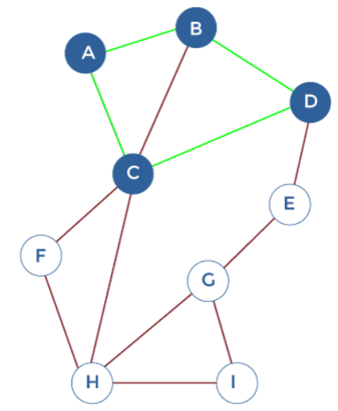
Graph Definitions
Cycle: is a closed walk where neither edges nor vertices are allowed to repeat. Only the starting vertex and ending vertex may be the same in a cycle.
Cycle: A, B, D, C, A
Walks, Trails, Path, Circuit and Cycle in Discrete mathematics - javatpoint
Notes:
14

Slide 15
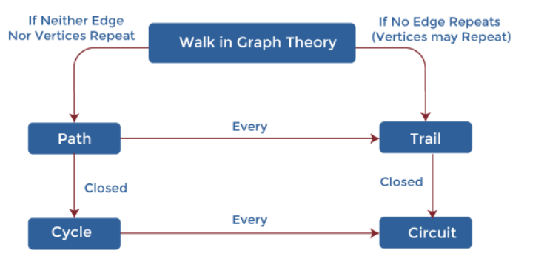
Graph Definitions
Walks, Trails, Path, Circuit and Cycle in Discrete mathematics - javatpoint
Notes:
15

Slide 16
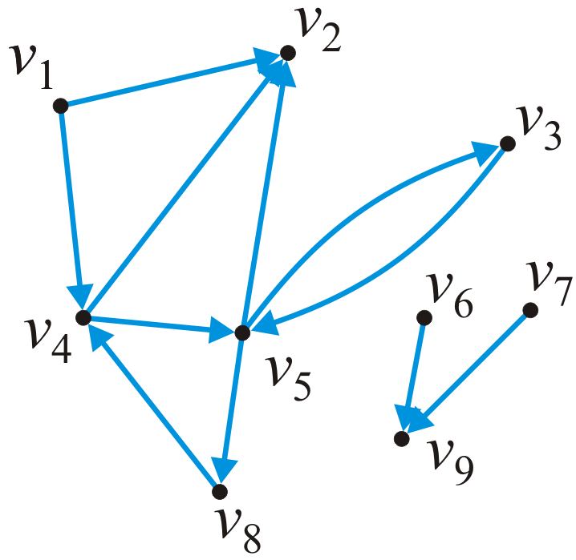
Paths and Cycles: Example
Another definition: A path in a directed graph is an ordered sequence of vertices
(v₁, v₂, ..., v_{k})
where (v_{j – 1}, v_{j}) is an edge for j = 1, ..., k
A path of length 5 in this graph is (v₁, v₄, v₅, v₃, v₅, v₂)
A simple cycle of length 3 is (v₈, v₄, v₅, v₈)

Slide 17
Graph Definitions
Directed Acyclic Graph (DAG): A directed graph with no cycles.
5
2
6
1
3
8
4
7
A directed acyclic graph
Notes:
17

Slide 18
More Graph Terminology
Edges incident on a vertex
a, d, and b are incident on V
Adjacent vertices
U and V are adjacent. (U,V) is in E
Degree of a vertex:
The degree of a vertex is the number of edges incident to that vertex
X has degree 5
For a directed graph,
the in-degree of a vertex v is the number of edges that have v as the head
the out-degree of a vertex v is the number of edges that have v as the tail
Self-loop
j is a self-loop
V
a
b
h
j
U
d
X
Z
c
e
i
W
g
f
Y

Slide 19
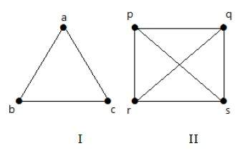
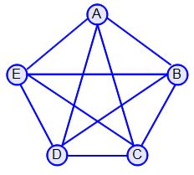
Complete Graphs: Undirected
Complete graph: For each pair of distinct vertices, there is exactly one connecting edge.
What is the number of edges in a complete undirected graph with N vertices?
Combination (N,2) = N * (N-1) / 2 →
Examples: Possible number of edges for complete graphs N=3: (3*2)/2 =3 , N=4: (4*3)/2=6 ,….
N=3 N=4 N=5

Slide 20
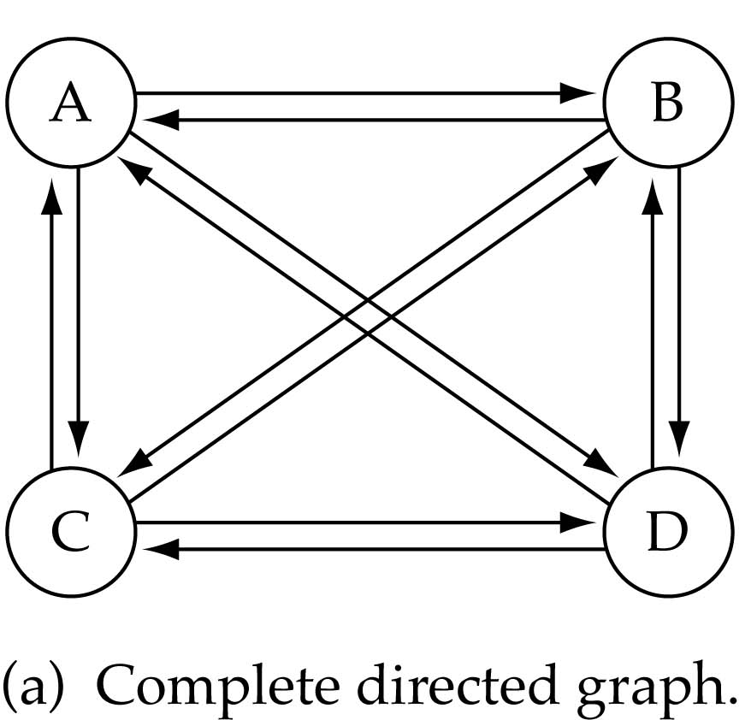
Complete Graphs: Directed
What is the number of edges in a complete directed graph with N vertices?
Permutation(N,2)=N*(N-1)→
Example: N=4
Possible number of edges
(4*3) = 12
→A complete graph has maximum number of edges.

Slide 21
Connected/Disconnected Graphs
Connected graph: An undirected graph in which there is a path from every vertex to every other vertex.
A graph is connected if any two vertices can be joined by a path. If this is not possible then the graph is disconnected
Connected vertices
Two vertices v_{i} and v_{j} are connected if there is a path that starts with v_{i} and ends with v_{j}.
Notes:
21

Slide 22
Connected Graph: Examples
0
0
1
2
1
2
3
3
4
5
6
G1
G2
acyclic graph

Slide 23
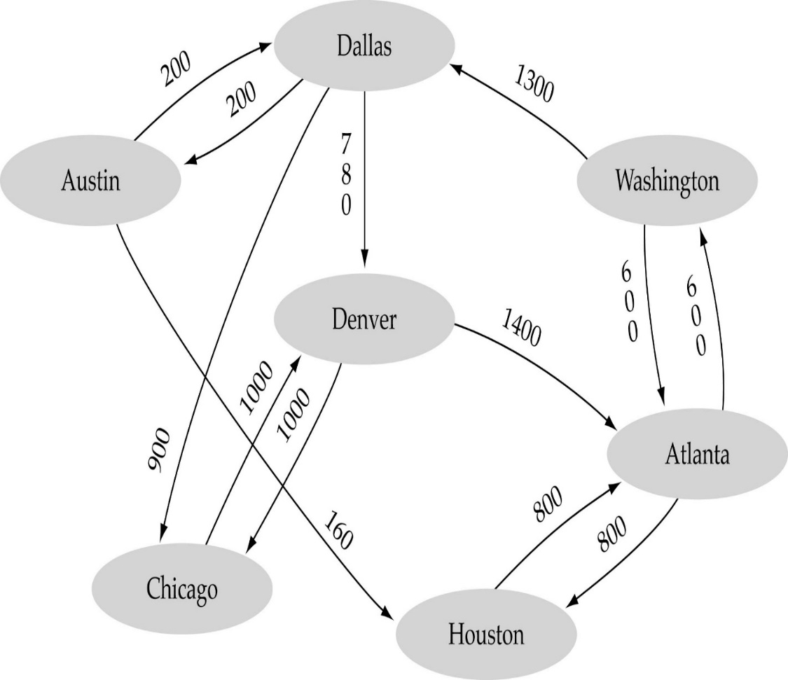
Weighted Graphs
Weighted graph: A graph in which each edge has an assigned number (weight).
Notes:
23

Slide 24
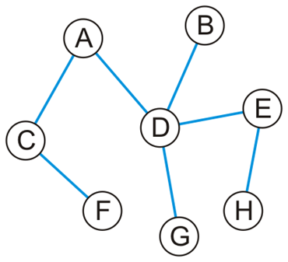
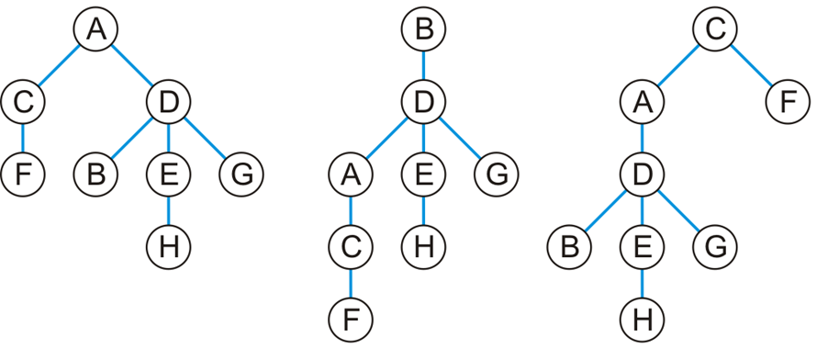
Trees are Special Cases of Graphs!
A connected acyclic graph is called a tree. →A tree is an undirected graph in which any two vertices are connected by exactly one path.
Graph G Three corresponding trees

Slide 25
Representation of Graph Structures
Two common ways of representing graphs as data structures:
Adjacency list: A graph of N nodes is represented by a one-dimensional array L of linked lists, where
The size of L is N (The # of nodes)
L[i] is the linked list containing all the nodes adjacent of node i.
The nodes in the list L[i] are in no particular order
Adjacency matrix: A Boolean matrix is used to represent the vertices and edges of a graph.

Slide 26
Graphs: Adjacency List Representation
Adjacency list: for each vertex v ∈ V, store a list of vertices adjacent to v in a list.
Example:
Adj[1] = {2,3}
Adj[2] = {3}
Adj[3] = {}
Adj[4] = {3}
1
2
4
3
If the graph is weighted, also in the adjacency list nodes, store weights.

Slide 27
Graphs: Adjacency List Representation
L [i]
1
2
3
4
5
1
2
3
4
5
2
1
2
3
1
5
5
5
5
2
1
5
3
4
4
2
3
3
4
An undirected graph Adjacency List Representation
Notes:
27

Slide 28
Adjacency lists: Directed Graphs
1
4
5
L [i]
1
2
3
4
5
6
2
4
2
3
3
6
4
1
2
3
4
5
6
2
3
6
6
A directed graph Adjacency List representation
Notes:
28

Slide 29
Adjacency List: Storage Complexity
Total # edges = |E|
Total # of vertices = |V|
For directed graphs:
The list array takes up O(|V|) space
Sum of lengths of all adjacency lists is
∑out-degree(v) = |E|
^{v∈V}
Total storage: O(|V| + |E|)
For undirected graphs:
Sum of lengths of all adjacency lists is
∑degree(v) = 2|E|
^{v∈V}
→Total storage: O(|V| + |E|)
No. of edges leaving v
No. of edges incident on v.
Edge (u,v ) is incident on u and v.

Slide 30
Adjacency Lists: Search Complexity
Worst case Search time for a node is O(|V|) and for an edge is:
For undirected graphs, # items in adjacency lists is Σ degree(v) = 2 |E|
For directed graphs, # items in adjacency lists is Σ degree(v) = |E|
→ For adjacency lists, worst case search and storage complexity is:
O(|V| + |E|)

Slide 31
Adjacency Matrix Represention
Assume V = {1, 2, …, n}
An adjacency matrix represents the graph as a n x n matrix A such that :
A[i, j] = 1 if edge (i, j) ∈ E (or weight of edge) = 0 if edge (i, j) ∉ E

Slide 32
Adjacency Matrix Representation: Directed Graph
Example:
A | 1 | 2 | 3 | 4
1
2
3
4
1
2
4
3

Slide 33
Adjacency Matrix Representation: Directed Graph
Example:
A | 1 | 2 | 3 | 4
1 | 0 | 1 | 1 | 0
2 | 0 | 0 | 1 | 0
3 | 0 | 0 | 0 | 0
4 | 0 | 0 | 1 | 0
1
2
4
3

Slide 34
Directed Graph: Example
 | 1 | 2 | 3 | 4 | 5 | 6
1
2
3
4
5
6
 | 1 | 2 | 3 | 4 | 5 | 6
1
2
3
4
5
6
 | 1 | 2 | 3 | 4 | 5 | 6
1 | 0 | 1 | 0 | 1 | 0 | 0
2 | 0 | 0 | 0 | 1 | 0 | 0
3 | 0 | 1 | 0 | 0 | 0 | 0
4 | 0 | 0 | 1 | 0 | 0 | 0
5 | 0 | 0 | 1 | 0 | 0 | 1
6 | 0 | 0 | 0 | 0 | 0 | 1
1
4
5
 | 1 | 2 | 3 | 4 | 5 | 6
1 | 0 | 1 | 0 | 1 | 0 | 0
2 | 0 | 0 | 0 | 1 | 0 | 0
3 | 0 | 1 | 0 | 0 | 0 | 0
4 | 0 | 0 | 1 | 0 | 0 | 0
5 | 0 | 0 | 1 | 0 | 0 | 1
6 | 0 | 0 | 0 | 0 | 0 | 1
2
3
6
A directed graph
Adjacency Matrix Representation
Notes:
34

Slide 35
Undirected Graph: Adjacency Matrix
If the graph is undirected, the adjacency matrix will be symmetrical: (A = A^{T} )
1
2
1 2 3 4
1
2
3
4
a
b
c
d
3
4
An undirected graph
Adjacency Matrix Representation

Slide 36
Undirected Graph: Adjacency Matrix
If the graph is undirected, the adjacency matrix will be symmetrical: (A = A^{T} )
1
2
1 2 3 4
1 0 1 1 1
2 1 0 1 0
3 1 1 0 1
4 1 0 1 0
a
b
c
d
3
4
An undirected graph
Adjacency Matrix Representation

Slide 37
Adjacency Matrix Representation: Complexity
How much storage does the adjacency matrix require?
O(|V| * |V|)
Finding all adjacent vertices to vertex v: O(|V|)
What is the minimum amount of storage needed by an adjacency matrix representation of an undirected graph with 4 vertices?
6 bits (Why?)
Undirected graph → matrix is symmetric
No self-loops → don’t need diagonals
Adjacency matrices usually require too much storage for large graphs, but can be very efficient for small graphs

Slide 38
Adjacency List vs. Adjacency Matrix
Adjacency List
More compact than adjacency matrices if graph has few edges
Requires more time to find if an edge exists
Adjacency Matrix
Always require n² space
This can waste a lot of space if the number of edges are sparse
Can quickly find if an edge exists

Slide 39
Basic Operations on Graphs
Insertion of Nodes/Edges in the graph – Insert a node into the graph.
Deletion of Nodes/Edges in the graph – Delete a node from the graph.
Searching on Graphs – Search an entity in the graph.
Traversal of Graphs – Traversing all the nodes in the graph.

Slide 40
Graph Traversals
Traversals of graphs are also called graph searches.
In tree traversals each node is visited only once.
In graphs, such a traversal is not always possible since graphs may include cycles.
To overcome this difficulty, each visited node can be marked to avoid repeated visiting.
Still we need to handle the problem of isolated nodes.

Slide 41
Graph Traversals
Given: a graph G = (V, E), directed or undirected
Goal: Systematically explore (Visit) every vertex and every edge
The path of traversal forms a tree on the graph:
Pick a vertex as the root
Choose certain edges to produce a tree
As in tree traversal, there are two different approaches for traversing a graph:
Breadth-first Search (Traversal): BFS
Depth-first Search (Traversal): DFS

Slide 42
Breadth-First Search
For a given graph G=(V, E) with a source vertex s, breadth first traversal systematically discovers every vertex that can be reached from the source vertex.
What is the idea behind BFS?
Build a tree over the graph
Look at all possible paths at the same depth before you go at a deeper level
Pick a source vertex to be the root, find (“discover”) its children, then children of children, …

Slide 43
Breadth-First Search

Slide 44
BFS with Queue, Example with Tree
A
B
C
D
E
F
G
H
Order processed: A, B, C, D, E, F, G, H
→"level-order" traversal

Slide 45
Implementing Breadth-first Search
A queue is used to arrange the traversal process.
Choose any vertex v as start, mark it as visited and enqueue it
While the queue is not empty
Dequeue vertex v from the queue
For each vertex adjacent to v that has not been visited:
Mark it visited
Enqueue adjacent nodes onto the queue
Continue until the queue becomes empty Note: if there are no unvisited vertices, the graph is connected, otherwise it is not connected.

Slide 46
Breadth First Traversal: Pseudocode
BFS (G, s) //Where G is the graph and s is the source node
let Q be queue.
Q.enqueue( s ) //Inserting s in queue until all its neighbour vertices are marked.
mark s as visited.
while ( Q is not empty)
//Removing that vertex from queue,whose neighbour will be visited now
v = Q.dequeue( )
//processing all the neighbours of v
for all neighbours w of v in Graph G
if w is not visited
Q.enqueue( w ) //Stores w in Q to further visit its neighbour
mark w as visited.

Slide 47
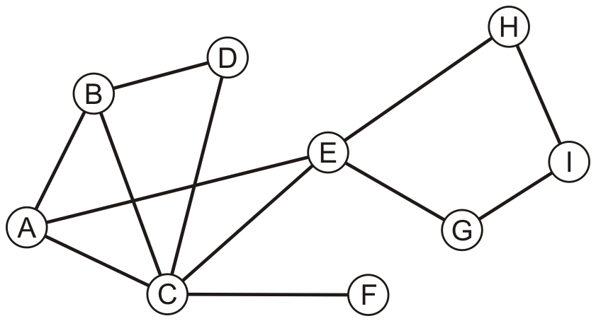
Tracing BFS Algorithm
How to perform a breadth-first traversal on the graph below?
The algorithm starts by choosing a start vertex: A
Enqueue the Start vertex onto the queue
Mark A as “visited” (Insert A to the list of visited nodes)
Visited: A
Queue
A

Slide 48
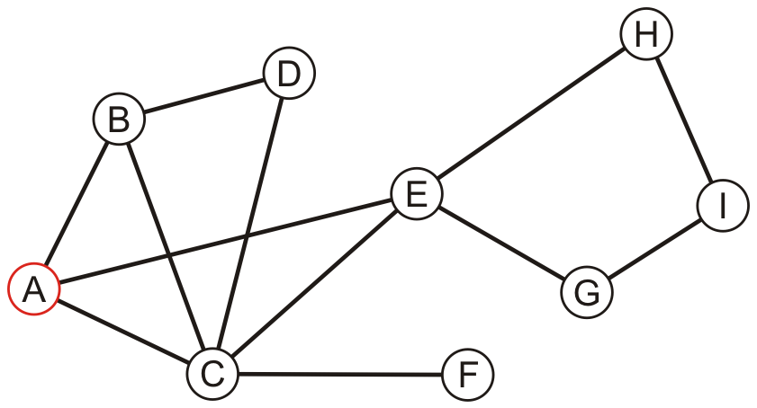
Tracing BFS Algorithm
Dequeue A. Unvisited neighbours of A are B, C and E
Visited: A

Slide 49
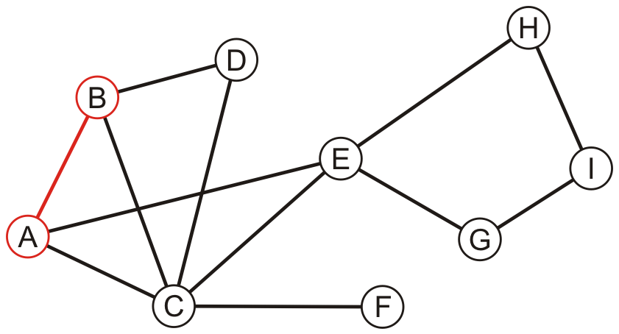
Tracing BFS Algorithm
Enqueue B. Mark B as “visited”
Visited: A, B
B

Slide 50
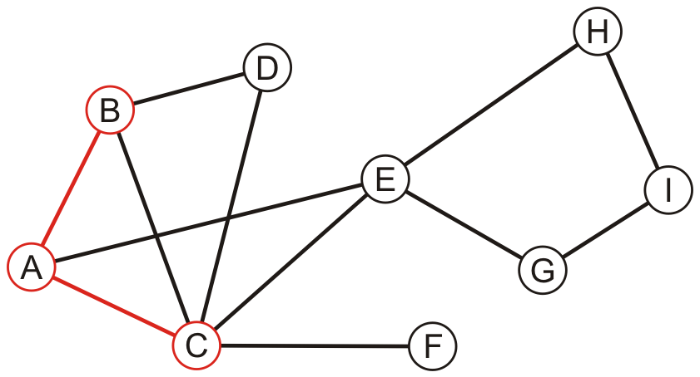
Tracing BFS Algorithm
Enqueue C. Mark C as “visited”
Visited: A, B, C
B | C

Slide 51
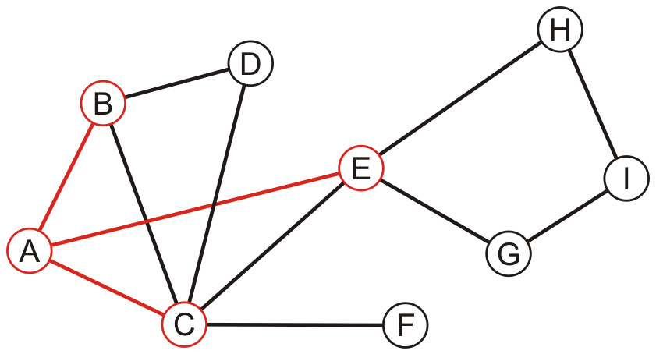
Tracing BFS Algorithm
Enqueue E. Mark E as “visited”
Visited: A, B, C, E
B | C | E

Slide 52
Tracing BFS Algorithm
Dequeue B. Unvisited neighbour of B is D
Visited: A, B, C, E
C | E

Slide 53
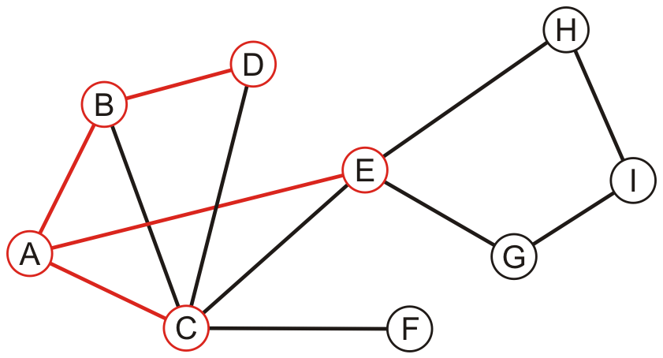
Tracing BFS Algorithm
Enqueue D. Mark D as “visited”
Visited: A, B, C, E, D
C | E | D

Slide 54
Tracing BFS Algorithm
Dequeue C. Unvisited neighbour of C is F
Visited: A, B, C, E, D
E | D

Slide 55
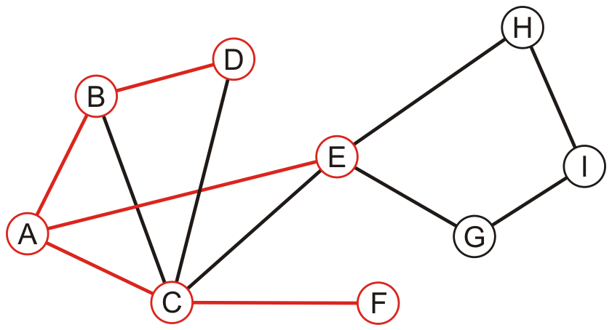
Tracing BFS Algorithm
Enqueue F. Mark F as “visited”
Visited: A, B, C, E, D, F
E | D | F

Slide 56
Tracing BFS Algorithm
Dequeue E. Unvisited neighbours of E are G and H
Visited: A, B, C, E, D, F
D | F

Slide 57
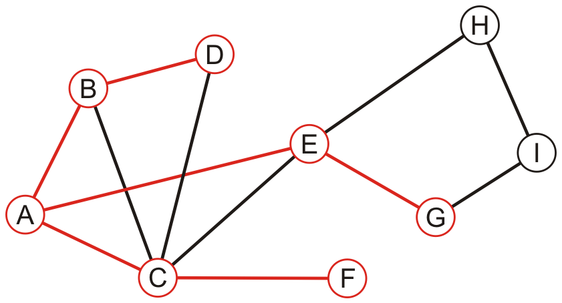
Tracing BFS Algorithm
Enqueue G. Mark G as “visited”
Visited: A, B, C, E, D, F, G
D | F | G

Slide 58
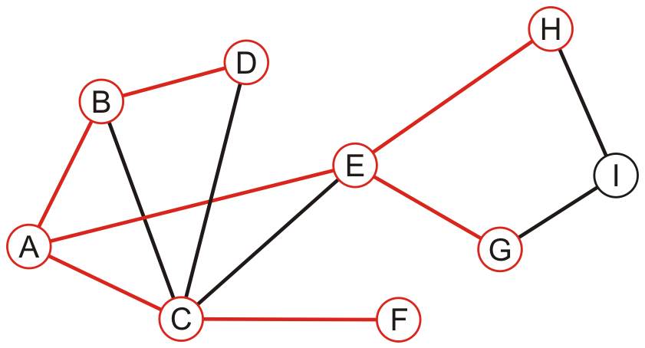
Tracing BFS Algorithm
Enqueue H. Mark H as “visited”
Visited: A, B, C, E, D, F, G, H
D | F | G | H

Slide 59
Tracing BFS Algorithm
Dequeue D. There are no unvisited neighbours of D
Visited: A, B, C, E, D, F, G, H
F | G | H

Slide 60
Tracing BFS Algorithm
Dequeue F. There are no unvisited neighbours of F
Visited: A, B, C, E, D, F, G, H
G | H

Slide 61
Tracing BFS Algorithm
Dequeue G. Unvisited neighbour of G is I
Visited: A, B, C, E, D, F, G, H
H

Slide 62
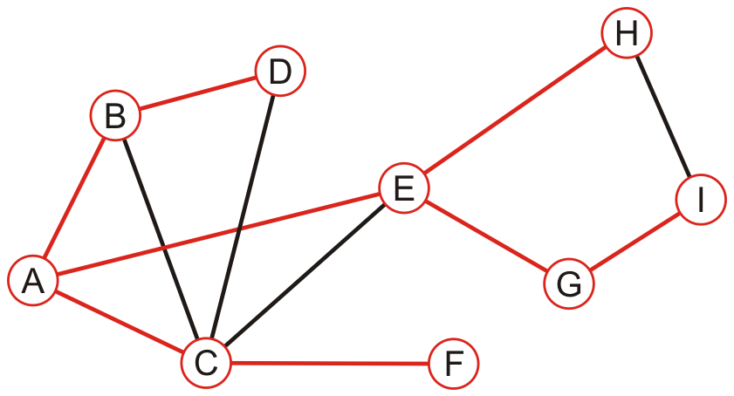
Tracing BFS Algorithm
Enqueue I. Mark I as “visited”
Visited: A, B, C, E, D, F, G, H, I
H | I

Slide 63
Tracing BFS Algorithm
Dequeue H. There are no unvisited neighbours of H
Visited: A, B, C, E, D, F, G, H, I
I

Slide 64
Tracing BFS Algorithm
Dequeue I. There are no unvisited neighbours of I
Visited: A, B, C, E, D, F, G, H, I

Slide 65
Tracing BFS Algorithm
The queue is now empty.
Finish the search. Graph is connected.
Final BFS List: A, B, C, E, D, F, G, H, I

Slide 66
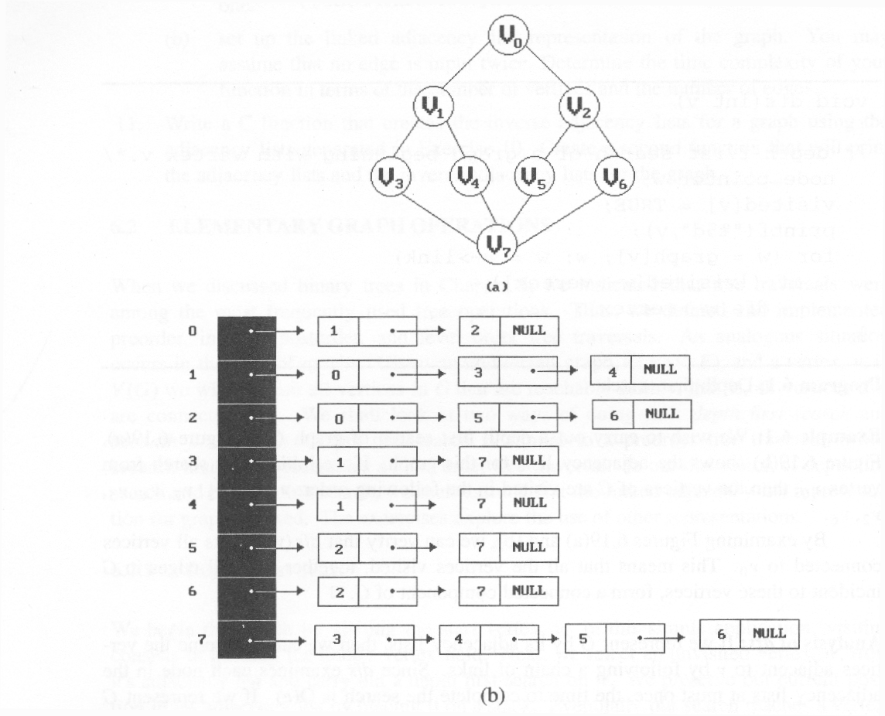
breadth first search: v0, v1, v2, v3, v4, v5, v6, v7

Slide 67
Time Complexity of Breadth-first Search
Adjacency List
A vertex is enqued at most once which takes O(1) time. A vertex is dequed at most once which takes O(1) time. Hence the total time for queuing operations for all vertices is 2 |V| = O(|V|).
Adjacency list is scanned at most once. Therefore the total time devoted for scanning adjacency list is 2 |E| = O(|E|).
→The total running time of breadth-first search is
T(n)= O(|V|+ |E|).
Adjacency Matrix :
Scanning each row for checking the connectivity of a Vertex is in order O(|V|) .
So, overall complexity is O(|V|²)
Space complexity of BFS is also O(|V|) (max. size of the queue).

Slide 68
Depth-First Search (DFS)
Similar to binary tree preorder traversal
Main idea:
Travel as far as you can down a path
When you reach a “dead end“ back up as little as possible until a vertex which has unvisited neighbors
Restart a DFS from this vertex
Continue until all vertices have been visited

Slide 69
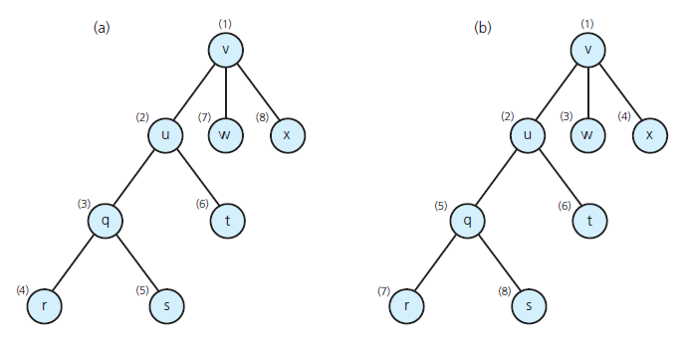
DFS and BFS Example-1
Visitation order for (a) a depth-first search; (b) a breadth-first search

Slide 70
DFS with Stack, Example with Tree
A
B
C
D
E
F
G
H
Order processed from right: A, C, F, H, G, B, E, D

Slide 71
DFS and BFS Example-2
depth first search: v0, v1, v3, v7, v4, v2, v5, v6
breadth first search: v0, v1, v2, v3, v4, v5, v6, v7

Slide 72
Depth First Traversal: Informal Algorithm
A stack is used to implement DFS.
Start by pushing any one of the graph's vertices on top of a stack.
Take the top item of the stack and add it to the visited list.
Create a list of that vertex's adjacent nodes. Add the ones which aren't in the visited list to the top of stack.
Keep repeating steps 2 and 3 until the stack is empty.

Slide 73
DFS: Pseudocode
//A stack is used for DFS implementation
DFS(G,v) //v is the start vertex
Stack S // start with an empty stack
for each vertex u
set visited[u] ← false //Initialize
push (S, v)
while (S is not empty) do
u ←pop (S)
if (not visited[u]) then
visited[u] ← true
for each unvisited neighbor w of u
push (S, w)
end if
end while
END DFS

Slide 74
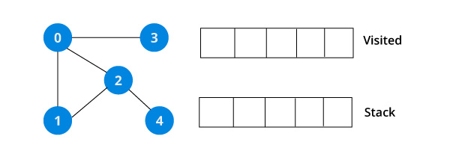
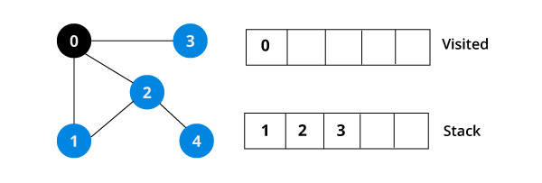
DFS Example
We start from vertex 0 (v in algorithm). Put it in the Visited list and put all its adjacent vertices in the stack:

Slide 75
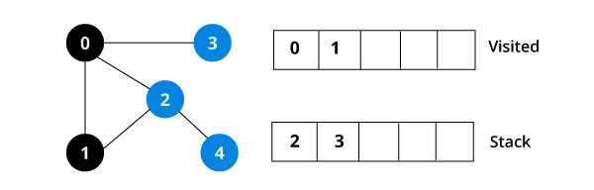
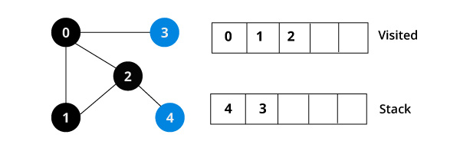
DFS Example
Next, we visit the element at the top of stack i.e. 1 and go to its adjacent nodes. Since 0 has already been visited, we visit 2 instead.
Vertex 2 has an unvisited adjacent vertex in 4, so we add that to the top of the stack and visit it.

Slide 76
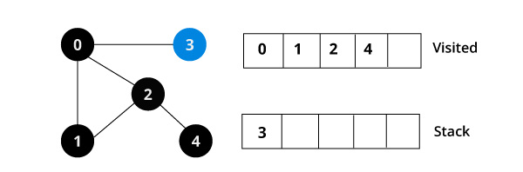
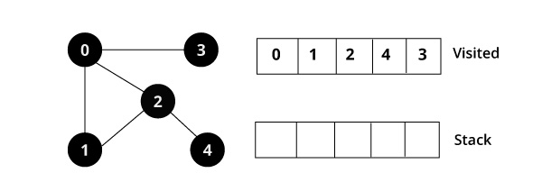
DFS Example
Next, we visit the last element 3, it doesn't have any unvisited adjacent nodes, so we have completed the DFS of the graph.

Slide 77
Complexity of DFS
Initialization takes O(|V|) time
The while loop in DFS takes O(|V|) time:
VISIT is performed once for each vertex. That is each adjacency list is scanned at most once. Therefore the total time for marking all adjacency lists is O(|E|).
For a Graph G=(V, E) we have :
When Adjacency List is used
Complexity is O(|V| + |E| )
When Adjacency Matrix is used
Scanning each row for checking the connectivity of a vertex is in order O( |V| )
So, DFS complexity is |V|²)
Space complexity of DFS is also O(|V|) in the worst case: we have to store the stack of vertices on the current search path.

